Slide 1
Week 5 – Lec 1
TCP Congestion Control

Slide 2
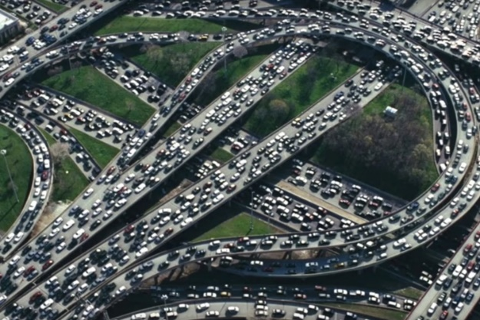


Principles of congestion control
Congestion:
informally: “too many sources sending too much data too fast for network to handle”
manifestations:
long delays (queueing in router buffers)
packet loss (buffer overflow at routers)
different from flow control!
congestion control: too many senders, sending too fast
a top-10 problem!
flow control: one sender too fast for one receiver

Slide 3

Causes/costs of congestion: scenario 1
original data: λ_{in}
throughput: λ_{out}
Simplest scenario:
Host A
one router, infinite buffers
input, output link capacity: R
infinite shared output link buffers
two flows
R
R
no retransmissions needed
Host B
R/2
Q: What happens as arrival rate λ_{in} approaches R/2?
λ_{out}
delay
throughput:
λ_{in}
R/2
λ_{in}
R/2
maximum per-connection throughput: R/2
large delays as arrival rate approaches capacity
λ_{in}
R/2

Slide 4

Causes/costs of congestion: scenario 2
one router, finite buffers
sender retransmits lost, timed-out packet
application-layer input = application-layer output: λ_{in} = λ_{out}
transport-layer input includes retransmissions : λ’_{in} λ_{in}
Host A
λ_{in} : original data
λ'_{in}: original data, plus retransmitted data
λ_{out}
R
R
Host B
finite shared output link buffers

Slide 5


Causes/costs of congestion: scenario 2
Realistic scenario: un-needed duplicates
packets can be lost, dropped at router due to full buffers – requiring retransmissions
but sender times can time out prematurely, sending two copies, both of which are delivered
R/2
λ_{out}
“wasted” capacity due to un-needed retransmissions
throughput:
when sending at R/2, some packets are retransmissions, including needed and un-needed duplicates, that are delivered!
Host A
λ_{in} : original data
λ_{in}
copy
λ'_{in}: original data, plus retransmitted data
R/2
timeout
free buffer space!
R
R
Host B
finite shared output link buffers

Slide 6
Causes/costs of congestion: scenario 2
Realistic scenario: un-needed duplicates
packets can be lost, dropped at router due to full buffers – requiring retransmissions
but sender times can time out prematurely, sending two copies, both of which are delivered
R/2
λ_{out}
“wasted” capacity due to un-needed retransmissions
throughput:
when sending at R/2, some packets are retransmissions, including needed and un-needed duplicates, that are delivered!
λ_{in}
R/2
“costs” of congestion:
more work (retransmission) for given receiver throughput
unneeded retransmissions: link carries multiple copies of a packet
decreasing maximum achievable throughput

Slide 7
Causes/costs of congestion: insights
throughput can never exceed capacity
delay increases as capacity approached
loss/retransmission decreases effective throughput
un-needed duplicates further decreases effective throughput
upstream transmission capacity / buffering wasted for packets lost downstream

Slide 8
Approaches towards congestion control
End-end congestion control:
no explicit feedback from network
congestion inferred from observed loss, delay
ACKs
data
data
ACKs
approach taken by TCP

Slide 9
TCP congestion control: AIMD
approach: senders can increase sending rate until packet loss (congestion) occurs, then decrease sending rate on loss event
Additive Increase
Multiplicative Decrease
increase sending rate by 1 maximum segment size every RTT until loss detected
cut sending rate in half at each loss event
AIMD sawtooth
behavior: probing
for bandwidth
TCP sender Sending rate
time

Slide 10
TCP AIMD: more
Multiplicative decrease detail: sending rate is
Cut in half on loss detected by triple duplicate ACK (TCP Reno)
Cut to 1 MSS (maximum segment size) when loss detected by timeout (TCP Tahoe)
Why AIMD?
AIMD – a distributed, asynchronous algorithm – has been shown to:
optimize congested flow rates network wide!
have desirable stability properties

Slide 11
TCP congestion control: details
sender sequence number space
TCP sending behavior:
roughly: send cwnd bytes, wait RTT for ACKS, then send more bytes
cwnd
last byte
ACKed
cwnd
sent, but not-yet ACKed
(“in-flight”)
available but not used
TCP rate
~
bytes/sec
~
RTT
last byte sent
TCP sender limits transmission:
cwnd is dynamically adjusted in response to observed network congestion (implementing TCP congestion control)
<
cwnd
LastByteSent- LastByteAcked

Slide 12
TCP slow start
Host A
Host B
when connection begins, increase rate exponentially until first loss event:
initially cwnd = 1 MSS
double cwnd every RTT
done by incrementing cwnd for every ACK received
one segment
RTT
two segments
four segments
summary: initial rate is slow, but ramps up exponentially fast
time

Slide 13
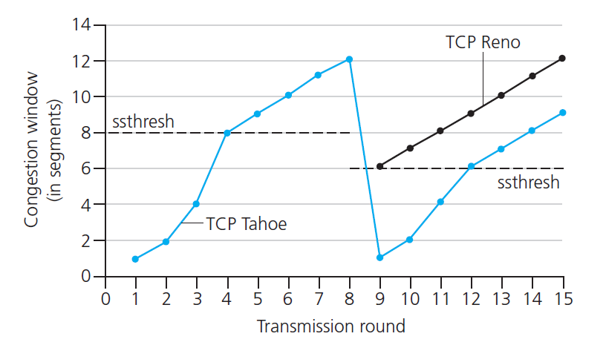

TCP: from slow start to congestion avoidance
Q: when should the exponential increase switch to linear?
A: when cwnd gets to 1/2 of its value before timeout.
X
Implementation:
variable ssthresh
on loss event, ssthresh is set to 1/2 of cwnd just before loss event
* Check out the online interactive exercises for more examples: http://gaia.cs.umass.edu/kurose_ross/interactive/

